Slide 1

OS Project

Slide 2

1
Implementation
2
Testing Program
3
Test Result
4
Simulation

Slide 3


01
Implementation
实现

Slide 4
wrr.c
enqueue_task_wrr
Add a task to ready queue of WRR.
dequeue_task_wrr
Remove a task from ready queue of WRR.
requeue_task_wrr
Put task to the head or the tail of the ready queue without the overhead of dequeue followed by enqueue.

Slide 5
wrr.c
yield_task_wrr
Move task to the tail of ready queue.
pick_next_task_wrr
Select the next task to run. If there is no ready task or the current round of WRR has reached the time limit, it returns a NULL pointer.
put_prev_task_wrr
Put the previous task back to the tail of ready queue if needed.

Slide 6
wrr.c
set_curr_task_wrr
Record the time when the task execution started.
task_tick_wrr
This function is invoked every 1ms and will update the remaining time slice of the task. When it finds that the task time slice is exhausted, it will recalculate the time slice and mark the task as needing rescheduling.
get_rr_interval_wrr
Calculate the time slice and weight by the group to which the task belongs.

Slide 7
Other Implementation
arch/arm/configs/goldfish_armv7_defconfig
init/Kconfig
include/linux/sched.h
include/linux/init_task.h
kernel/sched/core.c
kernel/sched/debug.c
kernel/sched/rt.c
kernel/sched/sched.h
kernel/sched/Makefile

Slide 8
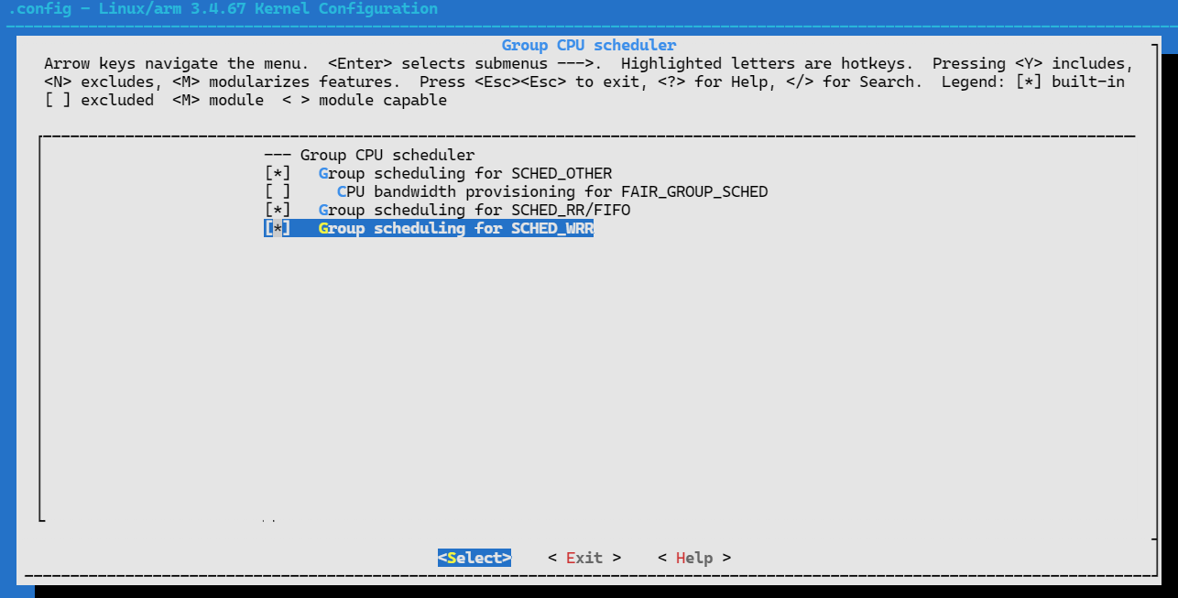
Other Implementation

Slide 9
02
Test Program
测试程序

Slide 10
Test Program
int sched_rr_get_interval(pid_t __pid, struct timespec *__t)
int sched_getscheduler(__pid_t __pid)
int sched_setscheduler(pid_t __pid, int __policy, const struct sched_param *__param)
int sched_get_priority_min(int __algorithm)
int sched_get_priority_max(int __algorithm)

Slide 11
Test Program
Get PID by command line:
/proc/[PID]/cmdline
Get cgroup in user space:
/proc/[PID]/cgroup

Slide 12
03
Test Results
测试结果

Slide 13
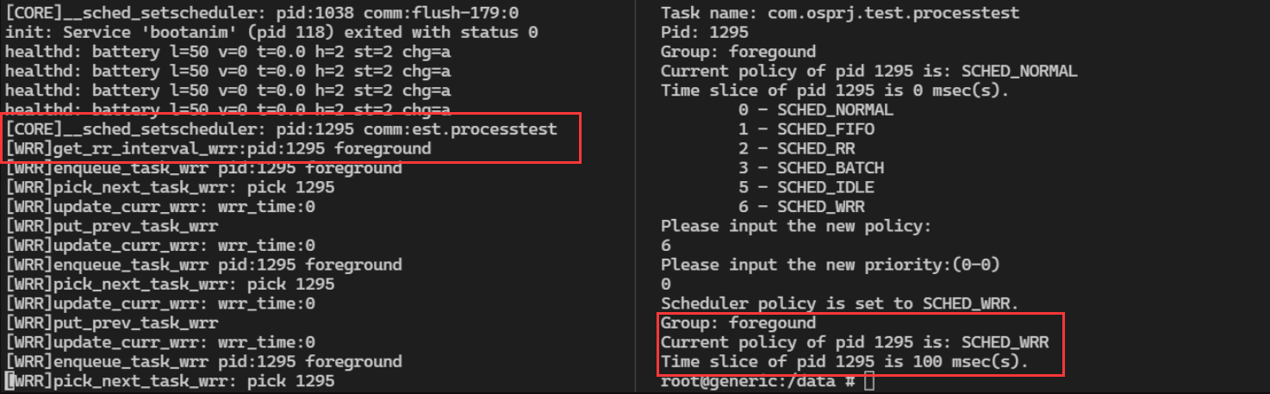
Test Results

Slide 14
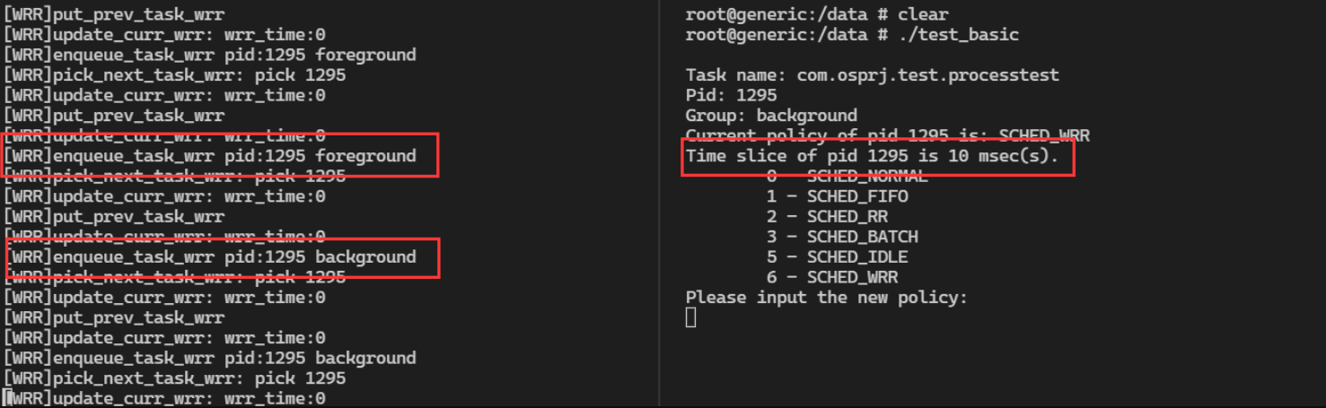
Test Results

Slide 15
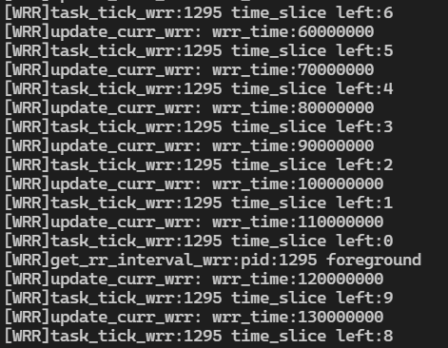
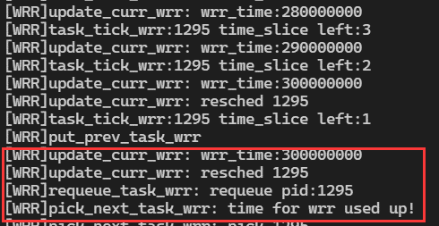
Test Result

Slide 16
04
Simulation
性能模拟

Slide 17
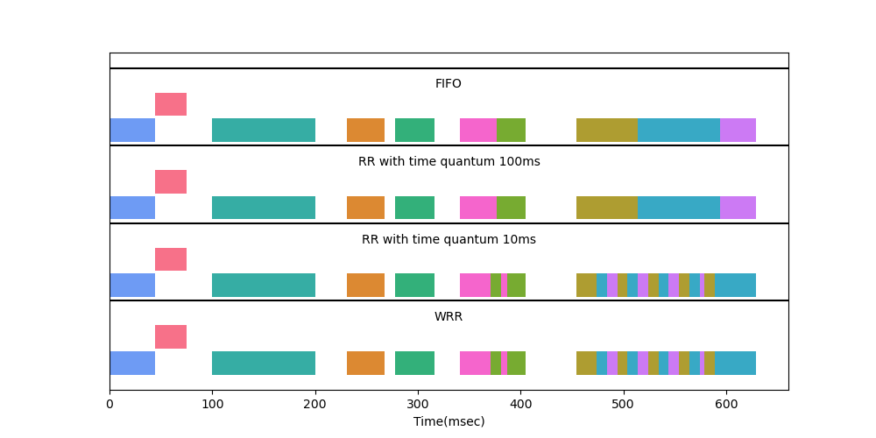
Simulation
System under low load

Slide 18
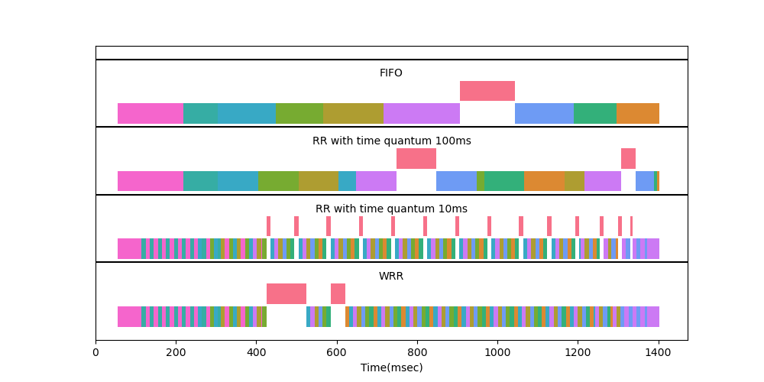
Simulation
System under high load

Slide 19
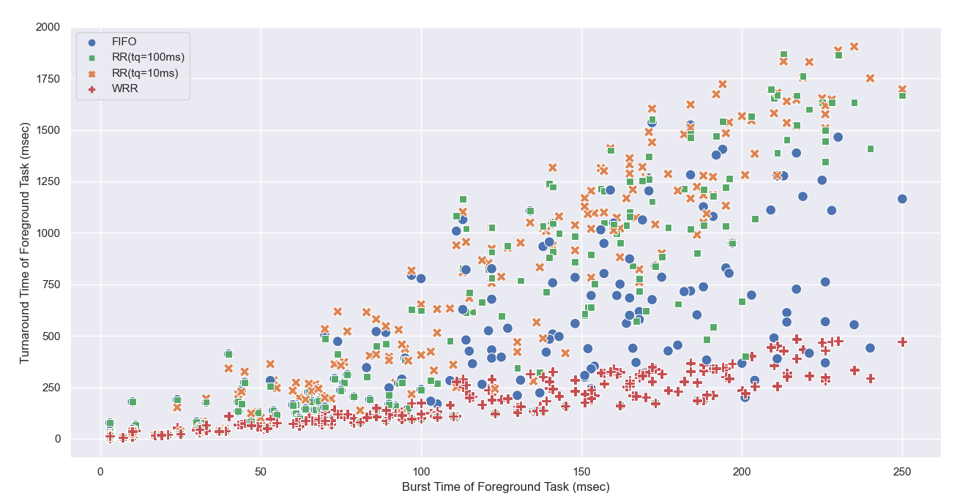
Simulation

Slide 20
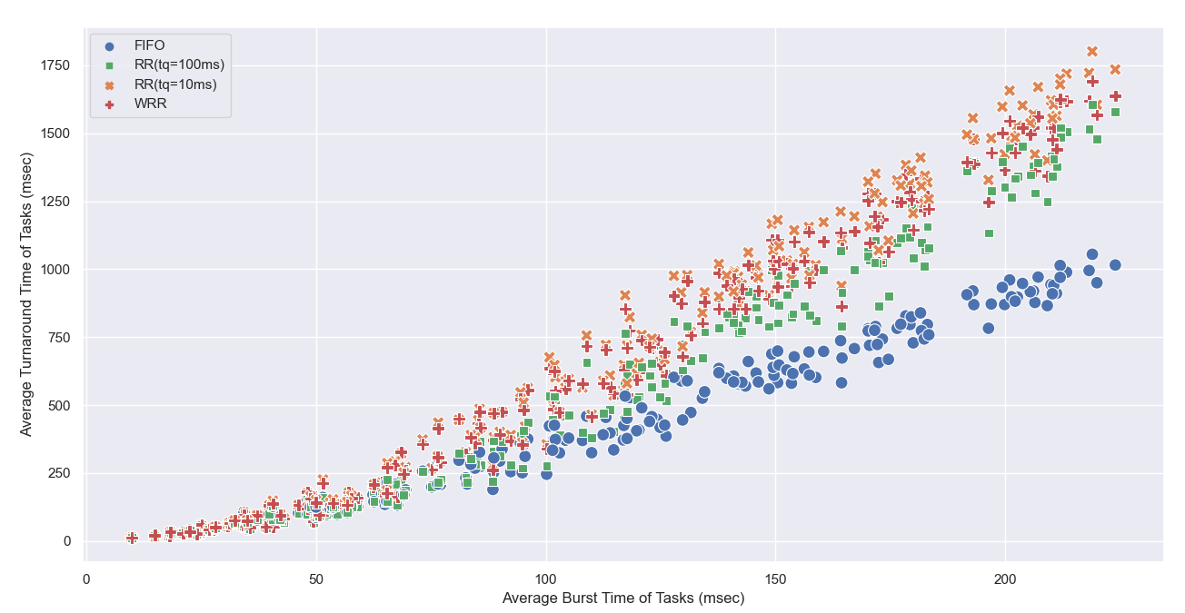
Simulation

Slide 21
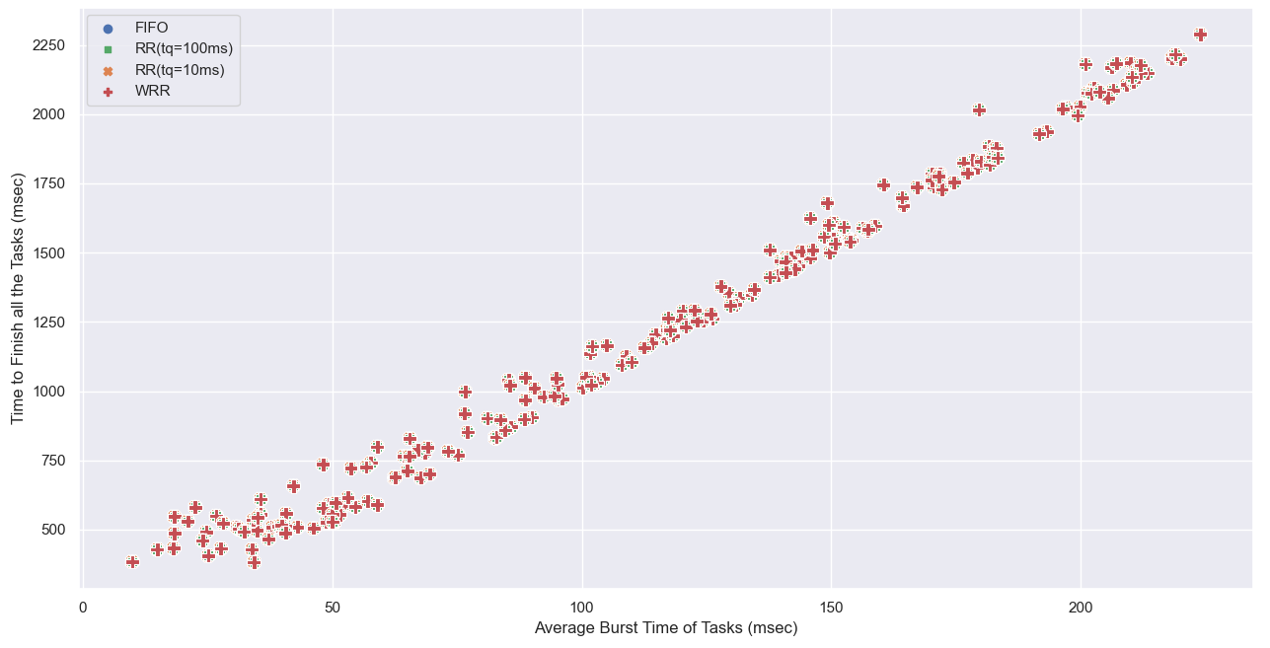
Simulation

Slide 22
Thanks

